Slide 1
Berkeley DB
By Shelby Hendrickx & Lucas van der Laan

Slide 2
Introduction
Data Model
Principles of Berkeley DB
Economics
Demo

Slide 3
Data Model
Key-Value Store
Pros:
Simplistic
Flexible
Scalable
Performance
Cons:
Lack of Standardization (e.g. no standards for keys)
Not OOP
No support for complicated searches
Notes:
What is key value ?
Simple because one on one mapping,
Flex -> can be any key and any value
Scal -> supporting huge data -> examples later

Slide 4
Data Model
Key-Value Store
Key | Value
John | johndoe@hotmail.com
Mammals | Bear, Cat, Dog, Elk, Fox
12984 | { first: “John”, last: “Doe”, age: “5” }
K1 | AAA, 2, 01/01/2015
0x352CDF3F | Img://cat.jpg, 120000, 01042019, john, 420
Notes:
Very different from relational databases.
RDB has pre-defined data struct, because it consists of tables with well defined data types, key-value -> treats all the data as a single collection, with different fields for every record
A Key-value store -> much more performant, far less memory
Keys and values can be anything

Slide 5
Data Model
Berkeley DB Specifics
Store Type
Ordered Key-Value Store
Size
2³² bytes key <–> 2³² bytes value
Database type
Embedded
Notes:
BerkeleyDB uses so-called Ordered key-value store -> advanced because it is sorted and makes easier to find data
Huge keys and values
Since time to copy a record is proportional to size, Berkeley interfaces allow for partial record retrieval where it only gets the bytes that are necessary
Embedded into application -> uses api calls

Slide 6
When to use
When you can predict data access patterns
Many customers -> don't have to buy, install, manage separate DB
Application remains unattended for long periods
End users are non-sophisticated administrators
Notes:
- especially when simple key-value queries AND because the queries can be coded up once -> will run very quickly because there is no SQL to parse and execute.
- because it is embedded into application

Slide 7
When NOT to use
Application needs different services
You can't predict how you need to access your data
Complex SQL Queries (non key-value queries)

Slide 8
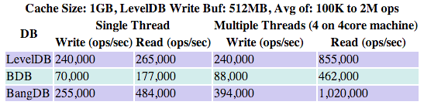
Principles of Berkeley DB
ACID
Performance
Querying
Limitations
http://highscalability.com/blog/2012/11/29/performance-data-for-leveldb-berkley-db-and-bangdb-for-rando.html
Notes:
ACID: Configured in the application (See transaction config

Slide 9
Principles of Berkeley DB
ACID
Atomicity
Consistency
Integrity
Durability

Slide 10
Principles of Berkeley DB
Limitations
Database Size depends on page size
Page size is chosen by application
Page sizes are saved as unsigned 16-bit numbers
Minimum page size: 512 bytes
Maximum page size: 65.536 bytes
Minimum-maximum database file size: 2^41 (2 terabytes)
Maximum database file size: 2^48 (256 terabytes)
Largest key/data item is 2^32
Maximum Btree depth: 255

Slide 11
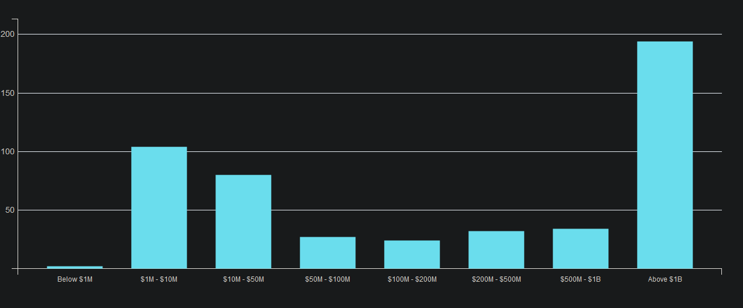
Economics
Market Share
Famous Case
Other
https://discovery.hgdata.com/product/oracle-berkeley-db
Notes:
Amazon
Bitcoin Core, until Bitcoin Core 0.8, changed to LevelDB

Slide 12
Demo

